Slide 1
Effect of US Macro Economic Factor on Indian Stocks.
Presentation By: Nitin Chaudhari

Slide 2
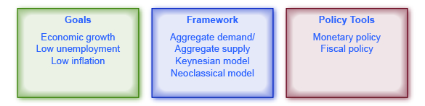
What Is Macro Economics?
Macroeconomics is a branch of economics that studies how an overall economy—the markets, businesses, consumers, and governments—behave.
Macroeconomics examines economy-wide phenomena such as inflation, price levels, rate of economic growth, national income, gross domestic product (GDP), and changes in unemployment.

Slide 3
3 Most Important Macroeconomic Factors that Affect Indian Stock Market
Dollar Index
Traders should note that there is an inverse relationship between the dollar index and the Indian stock market.
Thus, when the dollar index rises, it is likely to cause a fall in the share prices of those companies especially in cyclical sectors and domestic consumption sectors such as Banking, Automobiles, Oil and Gas, Capital Goods, Metals etc.
Crude oil
There is also an inverse relationship between the crude oil price and the Indian equity market.
Thus, strength in crude oil prices adversely affects these sectors that are oil-dependent and weakness in oil prices results in the rise in these companies’ stock prices.
US 10-year yield
When the yields increase then it also indicates that the Fed might raise interest rates for controlling inflation.
Due to this reason, many FIIs and global investors may pull out their money from Indian Stock Markets and invest in these bonds.
As a result, the prices of the stocks in the Indian stock markets may fall

Slide 4
How USD Became World’s Reserve Currency?
Before 1914 gold was world’s Reserve Currency and worlds all currency was linked with gold.
That means amount of currency printed were backed by physical gold in the treasury.
During the WW1 and WW2 countries in Europe exhausted their gold reserves.
Without gold, their currencies did not have any value.
US came forward and told that we had enough gold and our dollar is linked with it so you link your pound to the Dollar.
At that time 75% of the world’s gold reserves were concentrated with one country(US).
There was an agreement signed in 1944 which is called the “Bretton Woods Agreement”. In this agreement, it was decided US Dollar is STABLE so everyone can link their currency to US Dollar.
So in a way, the US Dollar became the world’s reserve currency.
Today, Central Banks keep 59% of their reserves in US Dollar.

Slide 5
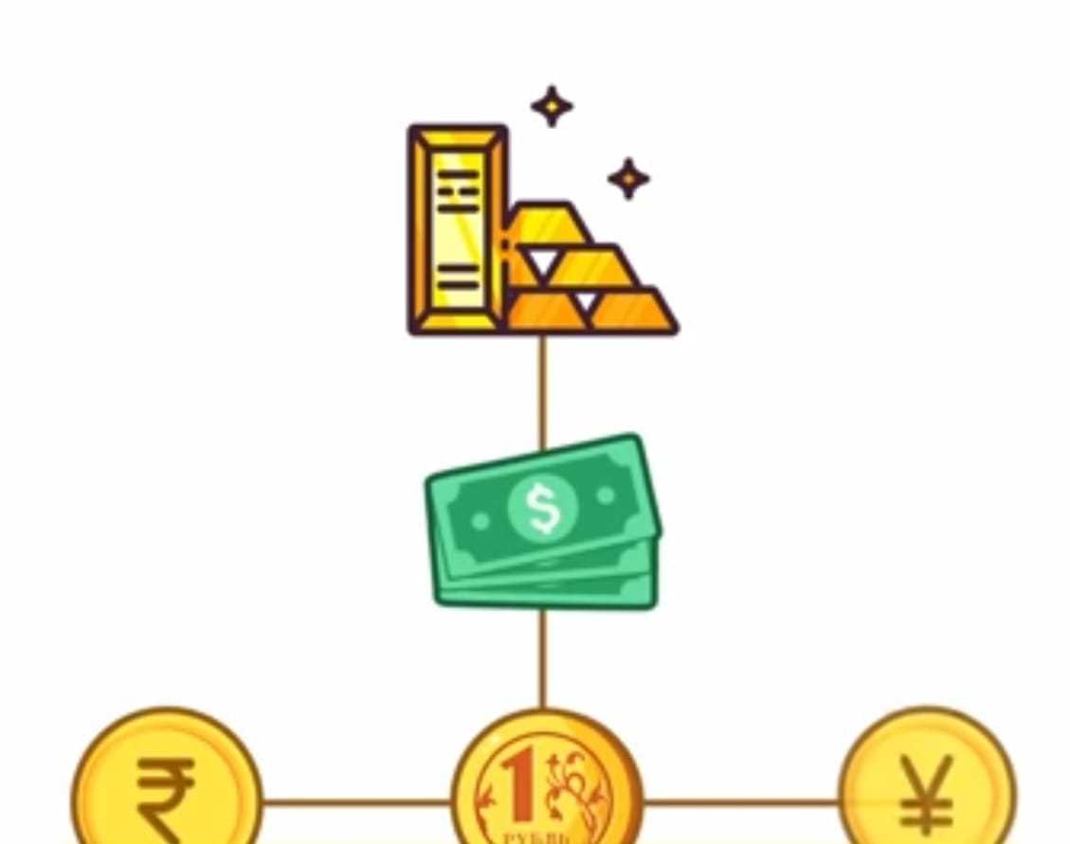
How US Dollar took the place of gold?
In 1971 president Nixon abolished the gold standard and they gave the FED(Federal Reserves) complete freedom to control US dollar.
If India want to buy a Rafale , first India should convert its Rupees into dollar then pays the France in US Dollars and after that France convert it into Euros and make payment to seller in Euros.
Its came with two major drawbacks.
Both country has to pay additional conversion charges
US dollar is controlled by US federal reservation.(By applying a sanction US able control which county can make a payment is USD)

Slide 6
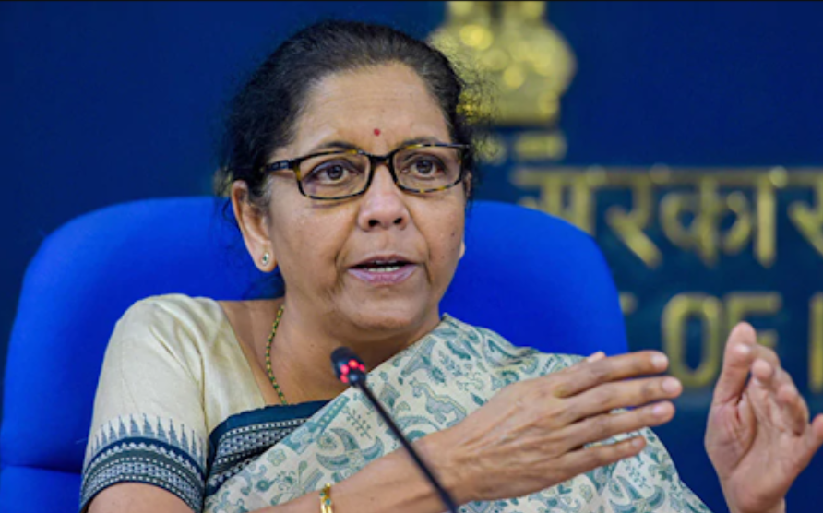
How US Dollar price is increasing?
The inflation rate in US started climbing from 2021 and inflation in 2022 may was the highest in past 40 years.
According to FED, Till the time consumer demand wont fall, inflation will not fall.
So FED started raising interest rates to fight inflation because of raising interest rates dollar rate is increasing.
Due to increasing in interest rate the supply of currency reduces in the market and its price rises.
Foreign investors pulling money out of other countries and they investing it in USD.
Because of this demand for the USD is growing and consequently, the prices as well.
President Nixon’s secretory said, “Dollar is our currency but your problem.”
Rupee Hasn’t Weakened, Dollar
Has Strengthened-It’s True.

Slide 7
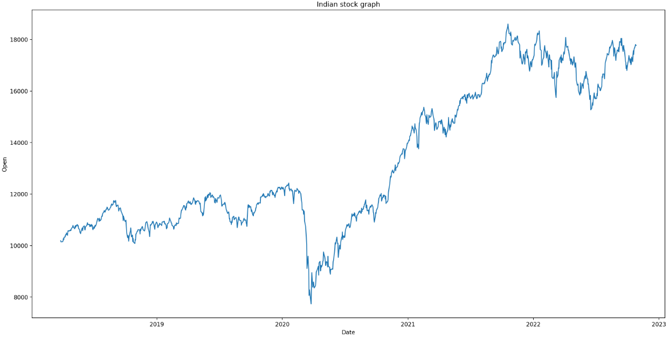
Nifty50 stock market graph from Mar 2018 to Oct 2022.
Inflation increased in US
FED increased interest rate, Dollar
Has Strengthened.
Mar,2020 lockdown was announced due to Pandemic

Slide 8
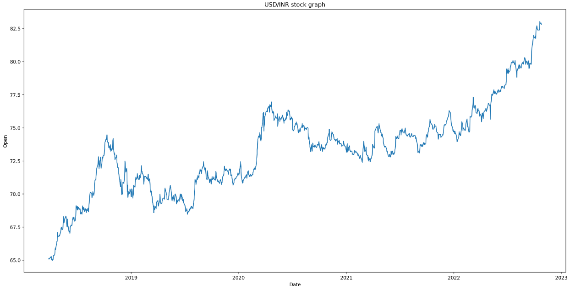
USD/INR stock market graph from Mar 2018 to Oct 2022.
To control inflation FED increased interest rate. This captured the attention of foreign investors
Due to pandemic world’s stocks collapsed and foreign investors start investing dollar
Inflation rate increased in US
Due to “Trump slump”

